Slide 1
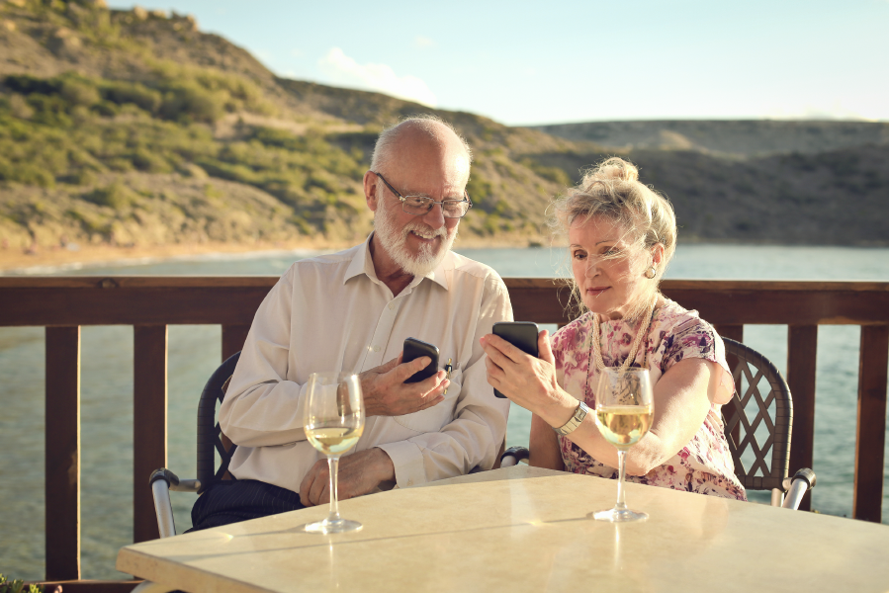
Organized Large Group Explorers Ideal Traveler Profile: Peter and Silvia & Visitor Experience Value Chain Analysis (VCA)

Slide 2
Organized Large Group Explorers Ideal Traveler Profile: Peter and Silvia & Visitor Experience Value Chain Analysis (VCA)

Slide 3
Organized large group explorers: Peter and Silvia
Who are they? Peter and Silvia are a well-travelled couple in their late 60s from the Netherlands They are empty nesters, retired and with a good income. They have traveled a lot in their lives both within Europe as well as outside. When they were younger and their kids vacationed with them, they only travelled independently. Now they take multiple trips a year, enjoying life. Sometimes they book a city trip within Europe, other times they drive to Germany and spend two weeks in a rented vacation home and other times they decide to book an organized group tour. They have already been an organized group tours in Egypt, Italy and Turkey.
What is their spending behavior?
For Peter and Silvia it is all about value for money. They have a good income but like to go on several trips per year. Before they book a trip they carefully compare the different options and see which trip gives them more value for their money. If a tour includes higher-rated hotels and offers more activities, they are willing to pay a higher price if they feel its worth it. They also understand if they book a budget tour, they will also only stay in basic hotels and will have to pay for extra’s. If the tour does not include all meals, they will sometimes eat in nice restaurants but never splurge.
How do they decide on their next destination and how do they prepare? Every fall they receive the travel brochures from their favorite tour operators. These brochures list all the destinations, tours, dates and prices for the next year. The information is also available online via the tour operator’s website. They look at the offerings for the coming season and see if there is any tour they are interested in. They might have a ‘bucket list’ of places they would like to go to. If there is a country that appeals to them, they will go online to find additional information. They will check out the standard of the hotels by going to sites such as Booking or Tripadvisor. They might also ask their travel agent for advice. They will compare similar tours offered by different tour operators. Safety and security is very important to them and they won’t travel to a destination if they feel it is not safe. They will just pick another destination and save the country for another year. They don’t have children at home so they are flexible in their booking and prefer to travel off-season as it cheaper, more quiet and more pleasant temperatures. They might ask friends or family if they any advice on what to expect in the destination.

Slide 4
Organized large group explorers: Peter and Silvia
What is their ideal organized tour?
Peter and Silvia like to travel to places they have not been before and they enjoy the company of the other travelers as well as the convenience of an organized trip. They are adventurous in terms of exploring new places but they like their trips to be well-organized and safe so they prefer to travel with a local tour operator who selects the most important sights to see and drives them safely from one place to the other and makes sure the hotels are decent standard. Their ideal holiday usually last between 7-14 days and gives them the opportunity to get to know the country they are traveling in. They like to travel with a guide so they really feel can learn about the country while at the same time rely on practical support when they need to.
What are their expectations about basic services in the destination?
Peter and Silvia have high expectations in terms of safety and reliability. They watch their driver and would like him to get enough sleep, to not drink alcohol and to not speed or take unnecessary risks while driving. They like their coach bus to be clean from the inside as well as the outside. They would love to feel connected to the driver and to have ‘small talk’ with him and for him to acknowledge them. From their guide they expect him or her to have good language skills, be knowledgeable, friendly and outgoing. They also expect their guide to tell them what to do and what not do (e.g. advice on tipping or what foods to try). They would like for the driver and the guide to sit at the same table when they eat and by the end of the trip to be considered as their friends.
From the hotels they expect cleanliness, good mattress and linens and a clean and functional bathroom. The rooms can be basic but they get really annoyed if small repairs have not be taken care off. They also expect the front of the house staff to speak a foreign language (e.g. English or German) and to be friendly. From their meals they expect some variety, the option to try local specialties but also to have a backup if they don’t like the local food. They like their routines and to have their meals served at the same time every day. When they travel around and stop at sights, it is important for them to be able to buy some refreshments and use a (clean) toilet.

Slide 5
Organized large group explorers: Peter and Silvia
What kind of activities do they like to engage in? Peter and Silvia travel to learn about new places and cultures. They like to learn a little bit about everything and visit the main sights. For example they like to learn about monasteries but only need to see one or two. At the ones they visit, they like to learn the most important facts and as well as some anecdotes. They enjoy opportunities to witness and be part of local traditions or local cultural events. They are interested in traditional agricultural practices and they love tasting food in such places where they can see how the food is made and how it reaches their table. They love destinations ‘where time has stood still and people still hang on to the traditional way of living”. They also would love to get an opportunity to meet locals. While they like to do some light hiking, they won’t engage in more strenuous activities. As they are bit older, they prefer not to have to stand too long. They love to take photos of all the places they visit and always like to buy some souvenirs to take home.
What do they do after they return?
Peter and Silvia love travelling but they enjoy returning home after a trip. They spend the days after their return uploading and sharing photos with their children and close friends. They will also provide feedback to the tour operator about their experience. If they enjoyed the tour, they will recommend it to their friends and family. They might keep in touch with some of the people they met on the trip and even plan to be on the same tour to the next country on their list.

Slide 6
Organized Large Group Explorers Ideal Traveler Profile: Peter and Silvia & Visitor Experience Value Chain Analysis (VCA)

Slide 7
Organized large group explorers: ANTICIPATION
Anticipation
Travel to place
Destination Experience
Travel back
Recollection
Ideal
Current
How do they think of Macedonia?
Look at the tour operator’s website to see what the different offerings are for the coming year
Go to a travel show and learn about Macedonia
Hear something about Macedonia in the general media that catches their attention and makes them think that it might be an interesting country to visit.
Read an article in the newspaper or website
Hear friends/ relatives talk about their recent travels in Macedonia
How do they find information for Macedonia?
Read the day-to-day itineraries as posted on the tour operator’s website
Call or chat online with the tour operator to get an answer on specific questions
Research articles in travel media and travel blogs on Macedonia
How do they think of Macedonia?
Travelers learn about Macedonia and the tours through the tour operators website or through the annual printed brochures the tour operators distribute. TUI Netherlands combines Macedonia and Montenegro in one annual 120-page brochure.
Tour operators TUI Netherlands and Corendon both also advertise Macedonia as a tourist destination on billboards and in newspapers.
Organized tours travelers are known to be brand loyal and base their choice of destination on the tour operator offerings for that year.
How do they find information for Macedonia?
They study the day-by-day itinerary provided by the tour operator and supplement that with information from websites such as Booking or Tripadvisor
Call or chat online with the tour operator to get an answer on specific questions
There are very few articles in the media on traveling in Macedonia.

Slide 8
Organized large group explorers: ANTICIPATION
Anticipation
Travel to place
Destination Experience
Travel back
Recollection
Ideal
Current
How do they book?
They book the packaged tour directly from the tour operator or travel agent but they research the places they will visit and stay through Tripadvisor and Booking.
They sometimes ask friends who have been or read blog posts and articles
How do they research before leaving?
They buy a guidebook in their native language
Research articles in travel media and travel blogs on Macedonia
General online research for places they are visiting
How do they buy trips (package or not)?
All of their activities are included in the travel package purchased with the operator.
How do they book?
The package is booked directly through the tour operator or via a travel agency. The actual booking is done via phone or website
How do they research before leaving?
They read one of the guidebooks on Macedonia. There is currently one guidebook for Macedonia written specifically for the Dutch market (ANWB). Bradt offers an English language guide for Macedonia. Lonely Planet has chapters on Macedonia in its guides on Europe and Eastern Europe.
How do they buy trips (package or not)?
Tour operators include the room, breakfast and all activities in the packages they sell. Some of the tours also include the lunches or dinners.

Slide 9
Organized large group explorers: ANTICIPATION
Anticipation
Travel to place
Destination Experience
Travel back
Recollection
Summary of Gaps and Opportunities
How do they think of Macedonia?
Inconsistent regularity and amount of articles on Macedonia in travel media
“There is insufficient destination marketing especially since Macedonia is a new and unknown destination. We can’t sell Macedonia by ourselves”- International tour operator
“Promoting Macedonia as a ‘cheap' destination will discourage higher-paying tourists from booking” - International tour operator
Lack of proactive effort to offset negative media coverage on refugee and political crisis.
“Out of the four trips we offer this season, we had to cancel the first one as there were not enough bookings. People feel Macedonia is currently not a safe or pleasant place to travel” - Dutch tour operator
How do they find information for Macedonia?
The Macedonia Timeless portal is not one the top hits when searching for tourism and Macedonia
Limited activity on national and local destination level in key social media (Facebook, Youtube)
How do they book?
Only only the Dutch and the Polish tour operators are offering large group tours in Macedonia. Tour operators in the UK and Germany are offering similar trips to other countries in the region but do not offer tours to Macedonia.

Slide 10
Organized large group explorers: TRAVEL TO
Anticipation
Travel to place
Destination Experience
Travel back
Recollection
Ideal
Current
Means of travel to Macedonia?
They travel by plane from home directly to Macedonia
Entry point in Macedonia?
Ohrid or Skopje by air
Do they need visa?
No need for visa for citizens of EU, US, Canada
Means of travel to Macedonia?
Travelers booking through TUI NL or Corendon use the respective charter flights from Amsterdam to Ohrid. Travelers from Israel will, starting June 2016, travel by charter from Tel Aviv to Ohrid. Groups from Poland use charters but not directly to Macedonia.
Entry point in Macedonia?
Ohrid and Skopje by air. The Polish tour operator Rainbow Tours has a charter flight from Poland to Thessaloniki in Greece. From there the group travels by bus entering Macedonia via Gevgelija
Do they need visa?
No need for visa for citizens of EU, US, Canada

Slide 11
Organized large group explorers: TRAVEL TO
Anticipation
Travel to place
Destination Experience
Travel back
Recollection
Summary of Gaps and Opportunities
Means of travel to Macedonia?
Limited direct flights with European cities.
Only tour operators which have their own charter airlines are currently offering organized large group tours to Macedonia
“We do not use Wizzair as a low-budget airline cannot give us the flexibility in booking that we require” - International tour operator

Slide 12
Organized large group explorers: DESTINATION EXPERIENCE
Anticipation
Travel to place
Destination Experience
Travel back
Recollection
Ideal
Current
How long do they stay?
They stay from 5-12 days
Where do they stay (locations)?
Besides visiting the key locations such as Ohrid and Skopje, they would visit other less visited locations in the central corridor and the eastern part of the country.
What type of accommodations do they use?
They would use accomodation that has sufficient number of rooms and offers a good price/qualitiy ratio without compromising the minimum standards.
How long do they stay?
The length of the tour varies between 5-10 days. Most of the shorter tours only cover the western part of Macedonia while the longer tours also include the eastern part.
Where do they stay (locations)?
The Dutch tour operators Corendon and TUI start and end their tours in Ohrid, Polish operator Rainbow Tours enters Macedonia from the border near Gevgelija. They follow the following itineraries:
Corendon: Ohrid (2 nights) - Kavardarci (1 night) - Strumica (1 night) - Skopje (1 night) - Ohrid (2 nights)
TUI: Ohrid (2 nights) - Demir Kapija (2 nights) - Berovo (1 night) - Skopje (1 night) – Ohrid (1 night)
Rainbow Tours: Thessaloniki (1 night) – Ohrid (2 nights)- Skopje (1 night) – Kratovo (1 night) – Krusevo (1 night) - Thessaloniki (1 night)
What type of accommodations do they use?
The tour groups stay in the larger hotels and tour operators require hotels to have at least 20 rooms. Tour operators will not split guests over two or more hotels. The itineraries of the tours are based upon the availability of suitable hotels. TUI uses hotels that are rated 4 star or higher while Corendon and Rainbow Tours use 3 star properties.

Slide 13
Organized large group explorers: DESTINATION EXPERIENCE
Anticipation
Travel to place
Destination Experience
Travel back
Recollection
siganage
dest8nation
Ideal
Current
How do they move around?
They use modern and clean coach buses with professional drivers.
What activities do they engage in? (How they book them, i.e. Viator?)
The tour operators have a choice of different activities to include in their packages suitable for their specific market segment.
What attractions do they visit?
They visit a wide range of attractions highlighting the nature and culture of Macedonia. The attraction are authentic and well-taken care off and can be toured with a specialized guide if needed. Near the attractions is a place to buy refreshments and use the toilet.
How do they move around?
They use coach buses, they will not split up the groups and use smaller buses. Not all the sites are accessible for large coach buses.
What activities do they engage in and which attractions do they visit?
The group tours offered by TUI and Corendon offer similar activities. See below for the itineraries for the Dutch tour operators as well as the Polish operator Rainbow Tours:
TUI: tour in Ohrid -boat tour to St. Naum – Heraklea – Stobi - winetour Stobi - winetasting Popova Kula - monasteries Vodoca and Velusa - village dinner in Gabrovo - Skopje (bazaar, Mother Theresa House, Old train station, Museum of Modern Art) - St Jovan Bigorski monastery.
Corendon: tour in Ohrid - boat tour to St. Naum – Heraklea - tour center of Bitola - monument Philip the Great – Stobi archeological site - Stobi winery - Vodoco monastery - tour center of Strumica -Skopje (old train station, Museum Mother Theresa, bazaar) - St. Pantelemon monastery - walk in Matka Valley and St. Mary church - St. Jovan Bigorski monastery.

Slide 14
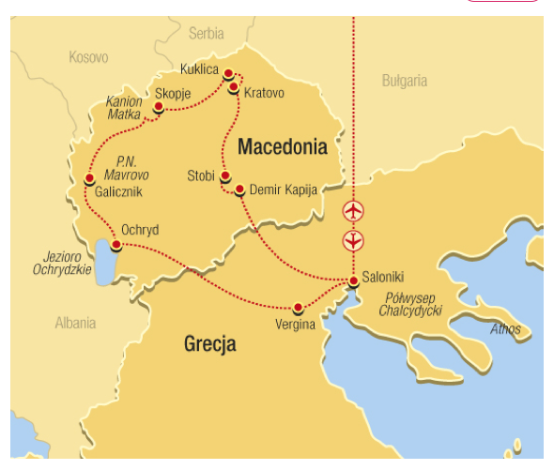
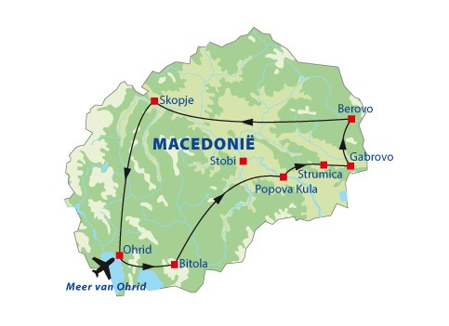
Organized large group explorers: DESTINATION EXPERIENCE
Anticipation
Travel to place
Destination Experience
Travel back
Recollection
Examples of itineraries
TUI (Netherlands) Rainbow Tours (Poland)

Slide 15
Organized large group explorers: DESTINATION EXPERIENCE
Anticipation
Travel to place
Destination Experience
Travel back
Recollection
Ideal
Current
Where and what do they eat (package or not)?
Some of the meais are included in the package but a number of lunches and dinners are not.
There are opportunties for the invidual travelers or the entire group to eat near the attractions or their hotel. Restaurants offer typical Macedonian dishes and the staff is friendly and speaks English.
The restaurants understand the needs of the international tour operator.
There are opportunities for the groups to eat a typical Macedonian meal in an authentic setting
It is possible to buy some of the traditional foods they tried and to take home.
What attractions do they visit? (cont.)
Rainbow Tours: tour in Thessaloniki – tour of Ohrid- boat trip to St. Naum – village of Galicnik (eating of local cheese, musueum – horseback riding in Mavrovo (optional) – Tour of Skopje- Mount Vodno, Fortress Kale- Stone Dolls in Kukljica – tour of Kratovo – Lesnovo monatery -Stobi – tour of Krusevo – wine tasting in Demir Kapija.
Where and what do they eat (package or not)?
None of the tours is completely inclusive and each offers a certain freedom in choice. The lower-end tours are more likely to include lunch and dinner during the entire tour. Many of the dinners are at the hotels where they are spending the night. The higher end tours leave more freedom and some of the included meals are in restaurants, which are not part of the hotel. Even though some of the meals are not included, it is custom for these type of tours for the guide to make a reservation for the group to still eat together.

Slide 16
Organized large group explorers: DESTINATION EXPERIENCE
Anticipation
Travel to place
Destination Experience
Travel back
Recollection
Ideal
Current
Where and what do they eat (package or not)?
Some of the meais are included in the package but a number of lunches and dinners are not.
There are opportunties for the invidual travelers or the entire group to eat near the attractions or their hotel. Restaurants offer typical Macedonian dishes and the staff is friendly and speaks English.
The restaurnants undertand the needs of the international tour operator.
There are opportunities for the groups to eat a typical Macedonian meal in an authentic setting
Are they guided/ unguided and independent/ group?
The groups travel with a local guide and use specialzied guides for specific attractions
See below for the specific arrangements per tour operator:
TUI: All of the breakfasts are included in trip price. Dinner is only included for two of the seven nights. One of these dinners is in Gabrovo (near Strumica) where the group enjoys dinner at a local family’s home.
Corendon: Breakfast and all of the dinners included in package. Excursions and lunches have to be bought as separate package which most people do buy. They eat in the hotels as well as lunch restaurants that can handle groups up to 40 people.
Rainbow Tours: Package includes breakfast and dinners.
Are they guided/ unguided and independent/ group?
All the tours are guided by a local guide. Most of the tours have guides communicating in English. They also use specialized guides at cultural attractions.

Slide 17
Organized large group explorers: DESTINATION EXPERIENCE
Anticipation
Travel to place
Destination Experience
Travel back
Recollection
Ideal
Current
How much do they spend?
Travelers have the opportunity to spend money outside their pre-paid package. This can be for additional activities, souvenirs or meals or snacks.
How much do they spend?
Corendon: The costs for the package is 400 Euros for eight-day trip. This includes flight, room, and all breakfasts and dinners. Excursions and lunch for extra 150 Euros.
TUI: The cost for the package is 542 Euros for eight-day trip. Includes room, breakfast and two dinners but excludes the flight. Flights are with TUIFly but are being charged separately
Rainbow Tours: The cost for the package is 545 Euros for eight-day trip. Includes room, breakfast and dinners and includes the flight. The tours does not include costs for excursions and guides (estimated 117 Euros extra).

Slide 18
Organized large group explorers: DESTINATION EXPERIENCE
Anticipation
Travel to place
Destination Experience
Travel back
Recollection
Summary of Gaps and Opportunities
How long do they stay?
The Dutch tour groups stay 8 days and the Polish tour groups six days. There is the opportunity to develop longer itineraries if the tours add destinations to their tour or if the Polish tour would fly directly to Macedonia.
Where do they stay (locations)?
While this market segment already has significant geographical spread, the eastern and central part of the country are underrepresented compared to the western region. Tour operators indicated that a lack of suitable hotels is the main reason not to expand beyond the current itineraries.
What type of accommodations do they use?
In some parts of the country there is a gap in quality accommodation for large groups (needing more than 20 rooms). The quality of some of the hotels is of minimum standard causing negative reviews on online travel sites such as Tripadvisor. The condition of the bathrooms is some of most often mentioned issues. Noise pollution is another often expressed view.
The service culture at some of the hotels is below travelers and tour operator's expectations
Hotel managers and staff do not have the basic English skills to meet the needs of the travelers
“At some of the hotels we stayed, we could not get to sleep until late at night as there was a wedding going on” – International tourist
How do they move around?
The tourists are generally pleased with the drivers. The Polish travelers feel there are too many people traveling in cramped buses.
The road infrastructure in some areas is poor and this makes some areas too time-consuming to visit
Speeding and road safety are an issue in Macedonia

Slide 19
Organized large group explorers: DESTINATION EXPERIENCE
Anticipation
Travel to place
Destination Experience
Travel back
Recollection
Summary of Gaps and Opportunities
What activities do they engage and what attractions do they visit?
Some of the current attractions, especially the infrastructure around natural and cultural sites is in disrepair. Improving infrastructure such as signage, rest places and paths would make these sites more safe and attractive to visit
International your operators mentioned that attractions such as craft markets or village visits become stale if there have been too many tour groups. Tour operators like to switch it off every now and then.
There is a lack of facilities such as toilets and stands to buy drinks or snacks
There is a lot of waste around some of the attractions
“Many of the people on the tour are older and are nervous about having access to toilets. I sometimes have to negotiate with café owners on how many cups of coffee I need to pay for in order for the group to use their toilet. The people don’t even want coffee, they just want to use the toilet” – Macedonian inbound tour operator
Where and what do they eat (package or not)?
Travelers on the lower-end tours are dissatisfied with the meals at the hotels and restaurant included in their package. Their main complaint is that it is cold, not enough variety and not typical Macedonian.

Slide 20
Organized large group explorers: DESTINATION EXPERIENCE
Anticipation
Travel to place
Destination Experience
Travel back
Recollection
Summary of Gaps and Opportunities
Are they guided/ unguided and independent/ group?
The feedback by travelers on their tour guide varies per tour operator ranging from moderately happy to very satisfied. The quality of the guides at the cultural heritage attractions is inconsistent.
“The guides are not very good storytellers. The only tell you the basic information and not their personal insights” – International tourist
“It is very difficult to find good guides (those that can speak foreign languages, have expert knowledge and have people skills)” – Macedonian inbound tour operator
How much do they spend?
The travelers on the lower-end group tours spend very little outside their packaged tour as all three meals are included. All drinks (non-alcoholic and alcoholic) are excluded from the package.
The higher-end tour do not include lunch and on some days also not the dinners. Travelers will have to pay for these separate and can decide where to eat. This provides opportunities for restaurants near attractions and hotels
There is very limited offerings in handicrafts, local food and other souvenirs that are attractive for the Western European market.

Slide 21
Organized large group explorers: DESTINATION EXPERIENCE
Anticipation
Travel to place
Destination Experience
Travel back
Recollection
Ideal
Current
Means of travel back?
Direct flight back to home country
Exit point from Macedonia (land/air and location?
Not applicable
Means of travel back?
Charter airlines
Exit point from Macedonia (land/air and location?
TUI and Corendon leave from Ohrid
Rainbow tours travel back to Thessaloniki

Slide 22
Organized large group explorers: TRAVEL BACK
Anticipation
Travel to place
Destination Experience
Travel back
Recollection
Summary of Gaps and Opportunities
Means of travel back?
Exit point from Macedonia (land/air and location?

Slide 23
Organized large group explorers: DESTINATION EXPERIENCE
Anticipation
Travel to place
Destination Experience
Travel back
Recollection
Ideal
Current
What feedback do they share?
They share their feedback of the experience including accomodation, restaurant and activities
What feedback do they share?
Travelers who have booked through Corendon and Rainbow Tours have the opportunity to provide feedback on the specific trip through the tour operators website. It is unclear if the tour operator filters the feedback before posting. The following shows the feedback through the tour operator portals:
Corendon - The tour received an average score of 7.2 based upon 30 reviews. The tour scores low on rooms (6.2) and food (7.0) and high on price/quality (7.7). The main complaints are: Low quality hotels with neglected rooms especially the showers, noise pollution from weddings/parties, rooms not clean, food was boring and plain and staff slow, not friendly or helpful. People do mention that is the quality in relationship to the low price they are paying is acceptable.
Rainbow Tours - The tour received an average score of 5.6 out of 6. Some of the complaints are the large size of the groups (43 people), noise pollution from hotels, uncomfortable bus.

Slide 24
Organized large group explorers: DESTINATION EXPERIENCE
Anticipation
Travel to place
Destination Experience
Travel back
Recollection
Ideal
Current
Where do they share feedback (online, social media, word of mouth)?
They share their photos and experiences online via Facebook, Instragram, tagging places.
They share their feedback via booking sites such as Zoover, Booking as well as review sites such as Tripadvisor.
Likelihood to return (curiosisity to come back)?
There are tours offered which are different enough for the traveler to return
Where do they share feedback (online, social media, word of mouth)?
Tour operator website (see above)
Direct feedback through word of mouth to family, friends and collegues is the main channel for sharing experienxes.
Facebook is the most popular type of social media for older travelers to share pictures of their trip. Other types of social media such as Instagram are less popular
Likelihood to return (curiosisity to come back)?
According to tour operators, travelers on an organized group tour are very unlikely to return to go on a similar trip. This also means that for some of the niche tour operators there is less demand after the tour has been offered for a few years.

Slide 25
Organized large group explorers: DESTINATION EXPERIENCE
Anticipation
Travel to place
Destination Experience
Travel back
Recollection
Summary of Gaps and Opportunities
What feedback do they share?
There is currently limited response by travel providers on negative or positive feedback by travelers
Where do they share feedback (online, social media, word of mouth)?
There is an opportunity to utilize innovate types of social media to share travelers experience to a wider audience
Likelihood to return (curiosisity to come back)?
Tours in less traveled areas of the country might entice travelers to book another tour to Macedonia

